Slide 1

Rocking Your Clouds with Docker
Mike Nelson
Solutions Architect,
Atlantis
Level: Beginner

Slide 2



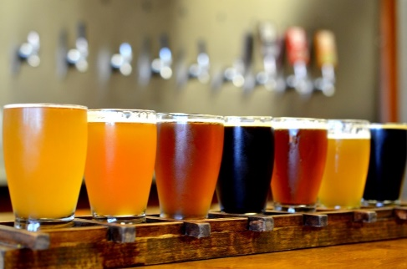
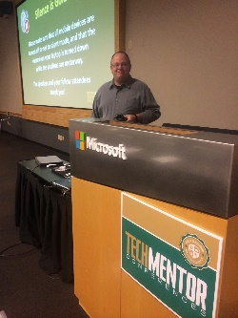

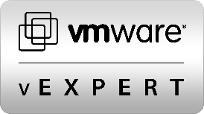




Slide 3
http://1drv.ms/1LdJyA0

Slide 4
Discuss
Containers
Docker
Linux
Azure, Windows, and Hyper-V containers
Managing It All
Let’s do some demo

Slide 5


Slide 6
A (really) Brief History of Containers
1960’s
Mainframe
1979
Chroot in Unix V7
1990-2000+
BSD Jails, Solaris Zones
Linux Vserver
2006
Process Containers
2008
LXC
2013
Docker
2014
Rocket

Slide 7
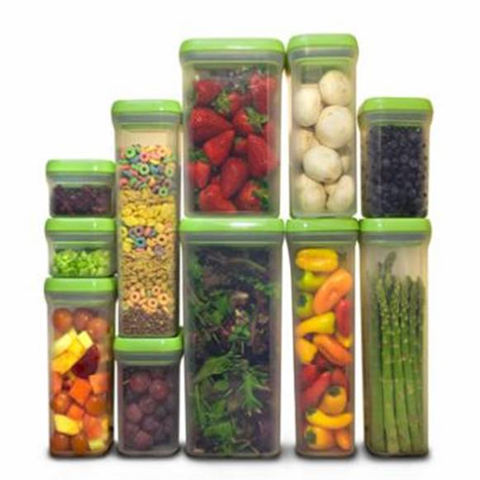
What are Containers?
What are Containers?
Containers are Operating System-level Virtualization.
Containers encapsulate applications into individual isolated environments on a shared operating system with their own processes, network, binaries, and libraries.
Docker is a container technology. It is also a management, API, and packaging platform for containers.
What is Docker?

Slide 8
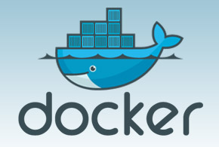

What is Docker?
“
Docker is a runtime for Linux Containers. It enables "separation of concern" between devs and ops,
“
Jerome Petazzoni – “Tinkerer Extraodinaire” at Docker

Slide 9
“
It’s about the applications
“

Slide 10
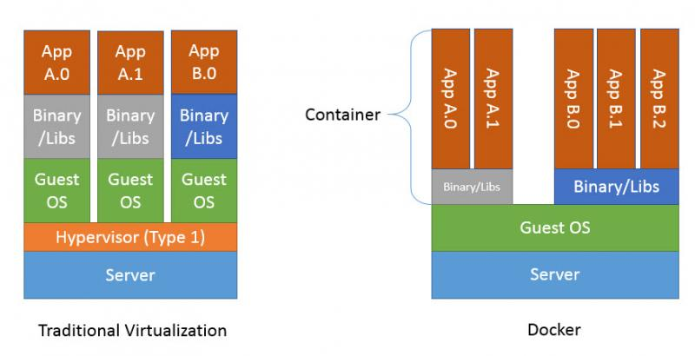
VM’s VS Containers
Notes:
Containers = almost no overhead, processes from on the host, memory/disk/COU a minimal besides app load

Slide 11
OS Cost
OS Cost
Density
Density
Virtual Machine
Container

Slide 12
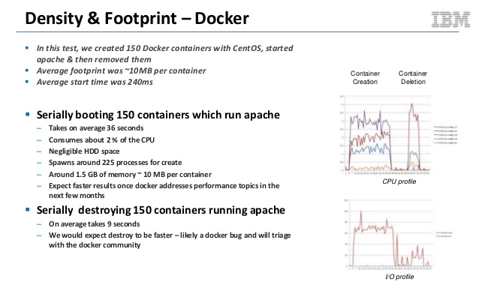

Slide 13
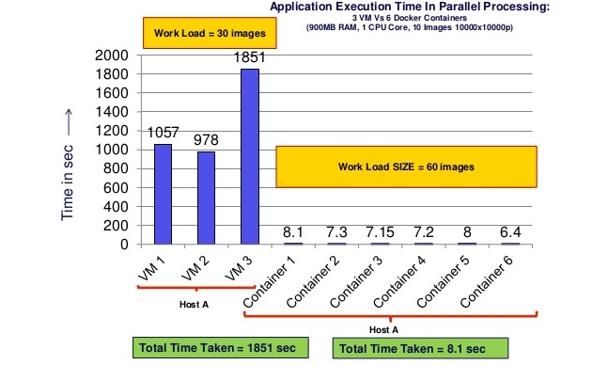

Slide 14
Density
Lower cost of OS
Agnostic – Hardware & Content
Separation of Duties
Portability
Isolation
Efficient & Lightweight
Why Containers Matter

Slide 15
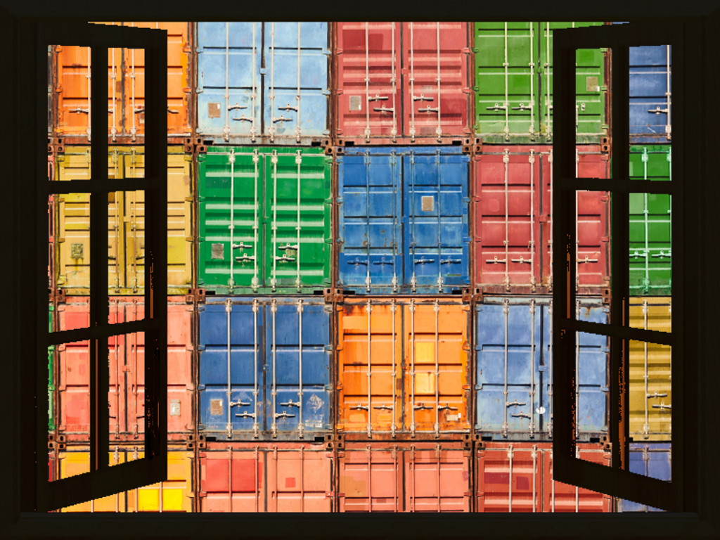
Opening Windows to Containers
Linux-
Azure support for Linux Containers
Windows Docker Toolbox (OS X, WIN)
Windows-
Windows Docker Machine (VirtualBox)
Windows Containers
Hyper-V Containers
PowerShell for Containers
Look for portability between platforms

Slide 16
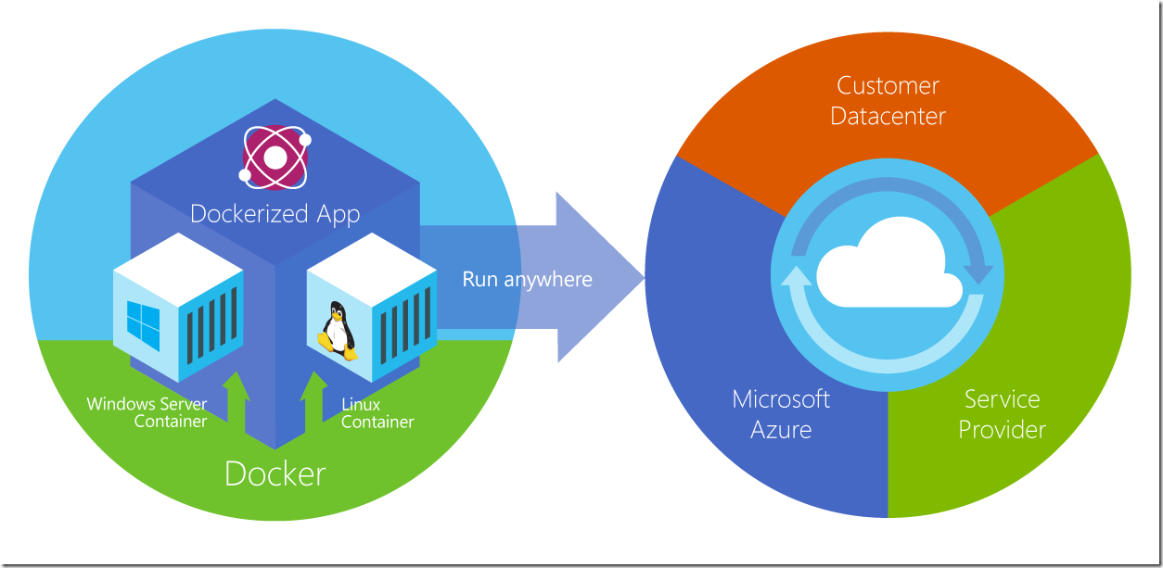
How Azure Sees It

Slide 17
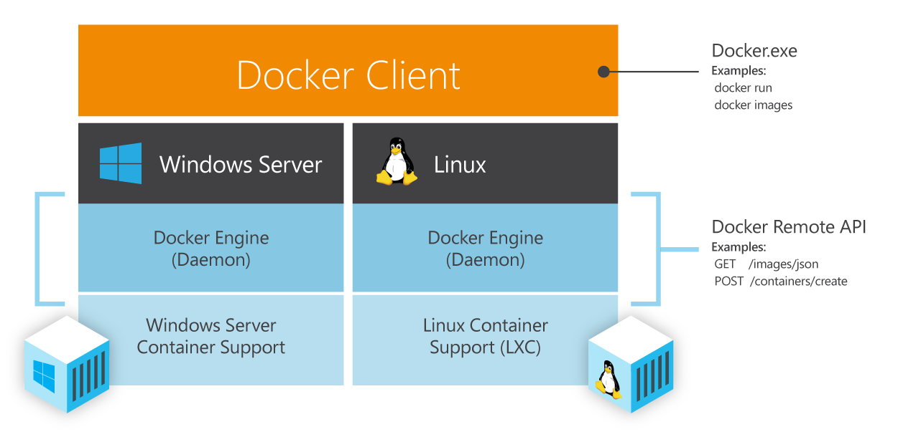

Not Much Difference Between Windows & Linux… Except the Obvious

Slide 18
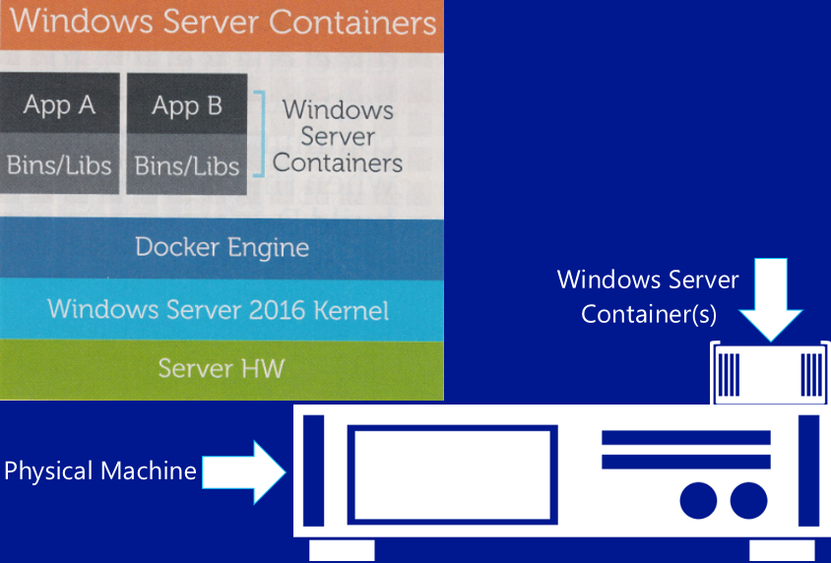

Architecture of a Windows Container

Slide 19
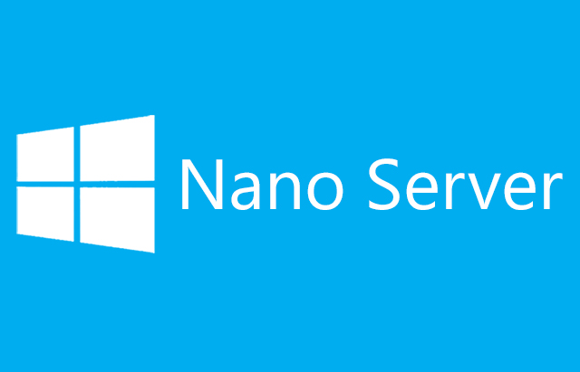
0.000.000.001
No login
No GUI
No RDP
No 32bit support
No MSI installer
One Billionth
WMI / PowerShell / DSC / …more
Patches - < twice a year (Hmm)
Fast boot
Core? Oh yeah, it’ll stick around

Slide 20
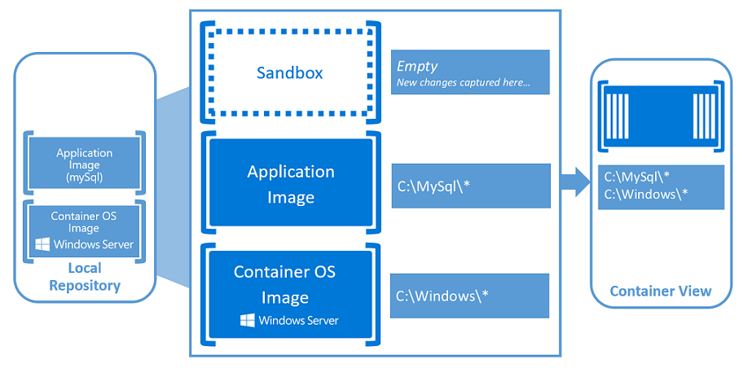
App Example in a Windows Container

Slide 21
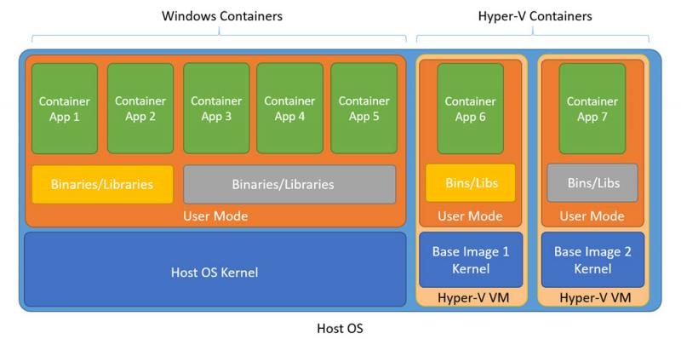
Differences Between Windows & Hyper-V Containers

Slide 22
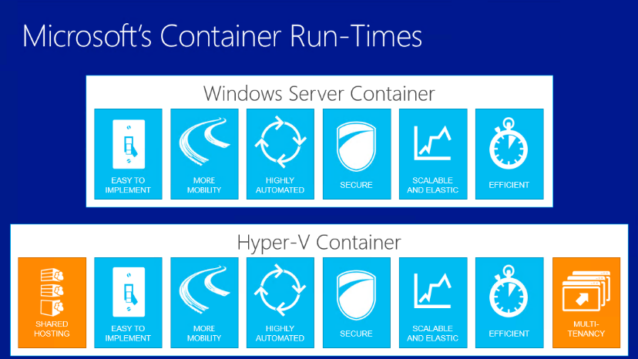
What’s the Difference?

Slide 23
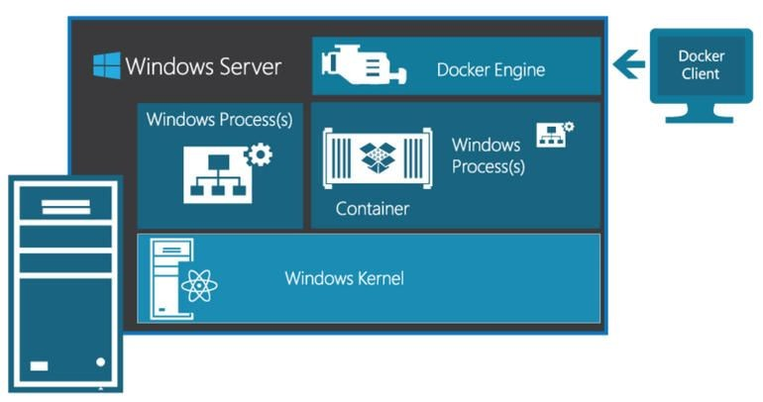
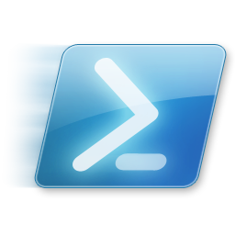
How It All Stacks Up in Windows

Slide 24
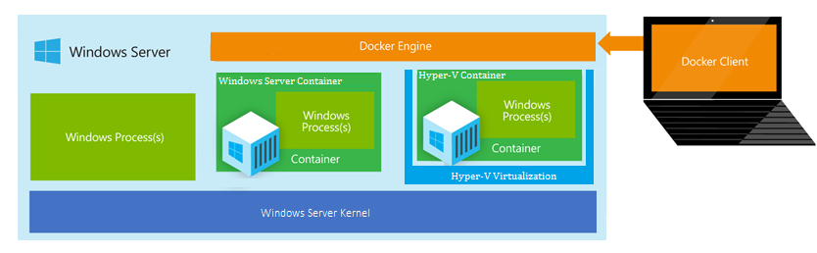
….As Well as Hyper-V

Slide 25
Compatible
https://msdn.microsoft.com/en-us/virtualization/windowscontainers/reference/ps_docker_comparison

Slide 26
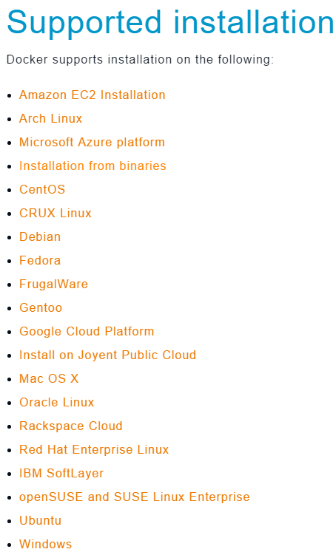
The Many Ways to the Docker Client
Linux – OS X - Windows
Repository install (apt, yum, etc)
curl D/L direct from Docker (latest)
Docker Toolbox
Azure CLI, templates
Visual Studio Extension
Kitematic
Vagrant
PowerShell
Server Feature
… and more
Chocolately

Slide 27
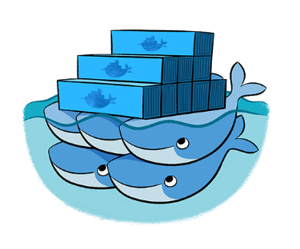
Docker Hub

Slide 28
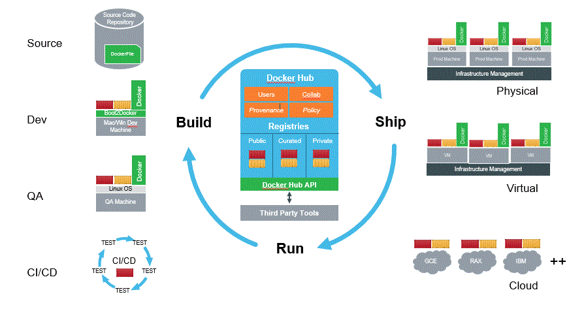
Repositories (Registries – “Hub”)
Push, Pull, Share, and Store
Official ones:
Hub
MySQL
mongoDB
PostgreSQL
Rails
Ruby
Java
WordPress
Redis
nGinx
Node
Ubuntu
Debian
CentOS
….. More

Slide 29
Docker Swarm
Clustering Docker containers into a single point of management & control
Docker Compose
Define and run multi-container Docker applications

Slide 30
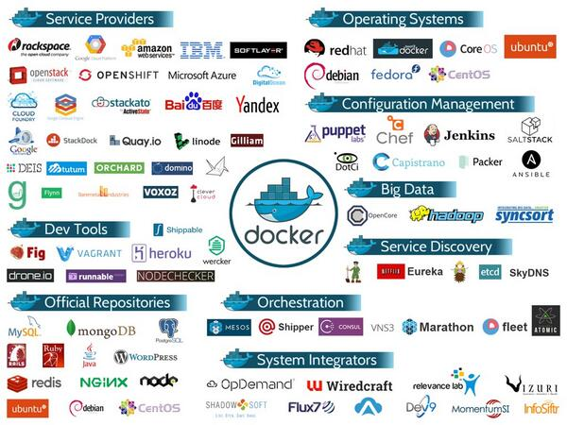

Slide 31
DEMO

Slide 32
Thank You!
Please fill out the surveys!

